Slide 1

DEPARTMENT OF COMPUTER SCIENCE AND TECHNOLOGY
MAJOR PROJECT
“Green Pulse - Energy Monitoring and Control Systems”
Mentor Group members
Prof. Abhik Mukherjee Tanuj Kaushik(2021CSB073)
Ashlesha Gautam(2021CSB076)
Neeharika Sharma(2021CSB106)
Devans Soni(2021CSB026)
Rohit Yadav(2021CSB050)
Sourik Saha(2021CSB072)

Slide 2

INTRODUCTION
Green Pulse is a web-based system developed to monitor and control energy usage on PCs, mobile devices, and AI models in real time.
It tracks vital system metrics like CPU usage, memory load, execution time, and energy consumption to help users understand their device’s power behavior.
The system supports both predefined AI models (ANN, CNN, RNN) and user-uploaded models, offering energy analytics and performance insights for each.
Interactive controls such as brightness adjustment, dark mode, and power-saving modes are included to reduce consumption effectively.
Green Pulse aims to promote sustainable computing practices by combining performance optimization with energy awareness.

Slide 3
Why Do We Need This Project ?
Rising Digital Energy Demands: Global electricity use rose 4.3% in 2024, driven by AI and cloud apps, with data centers alone using 460 TWh (2% of global demand).
Lack of Awareness: Households using energy-monitoring apps cut usage by 19.87%, yet most users still misjudge device energy impact.
Environmental Responsibility: Efficiency improvements avoided 4 gigatonnes CO₂ in 2017, and Energy Star saved $500B and 4B tons of CO₂ since 1992.
AI & ML Consumption: AI data centers used 1.5% of global electricity in 2024, expected to double by 2030 with 15% yearly growth
User Empowerment: 60% of users want live energy data and 75% seek smart saving tips, showing real demand for control tools like dark mode and power saving.

Slide 4
"Now, let us walk you through the main sections of our Green Pulse system, each designed to handle a specific aspect of energy monitoring and control."
1. DASHBOARD
The Dashboard serves as the core interface of the Green Pulse system, offering real-time insights into system performance and energy usage. It includes:
Memory usage, RAM utilization, and Battery status in live view.
Energy Consumption, calculated using a refined formula that considers both CPU and Memory usage:
This provides a more accurate reflection of real system energy behavior.
A real-time line graph of Energy vs. Time shows how consumption evolves during operation, helping users identify and respond to high-energy events.

Slide 5
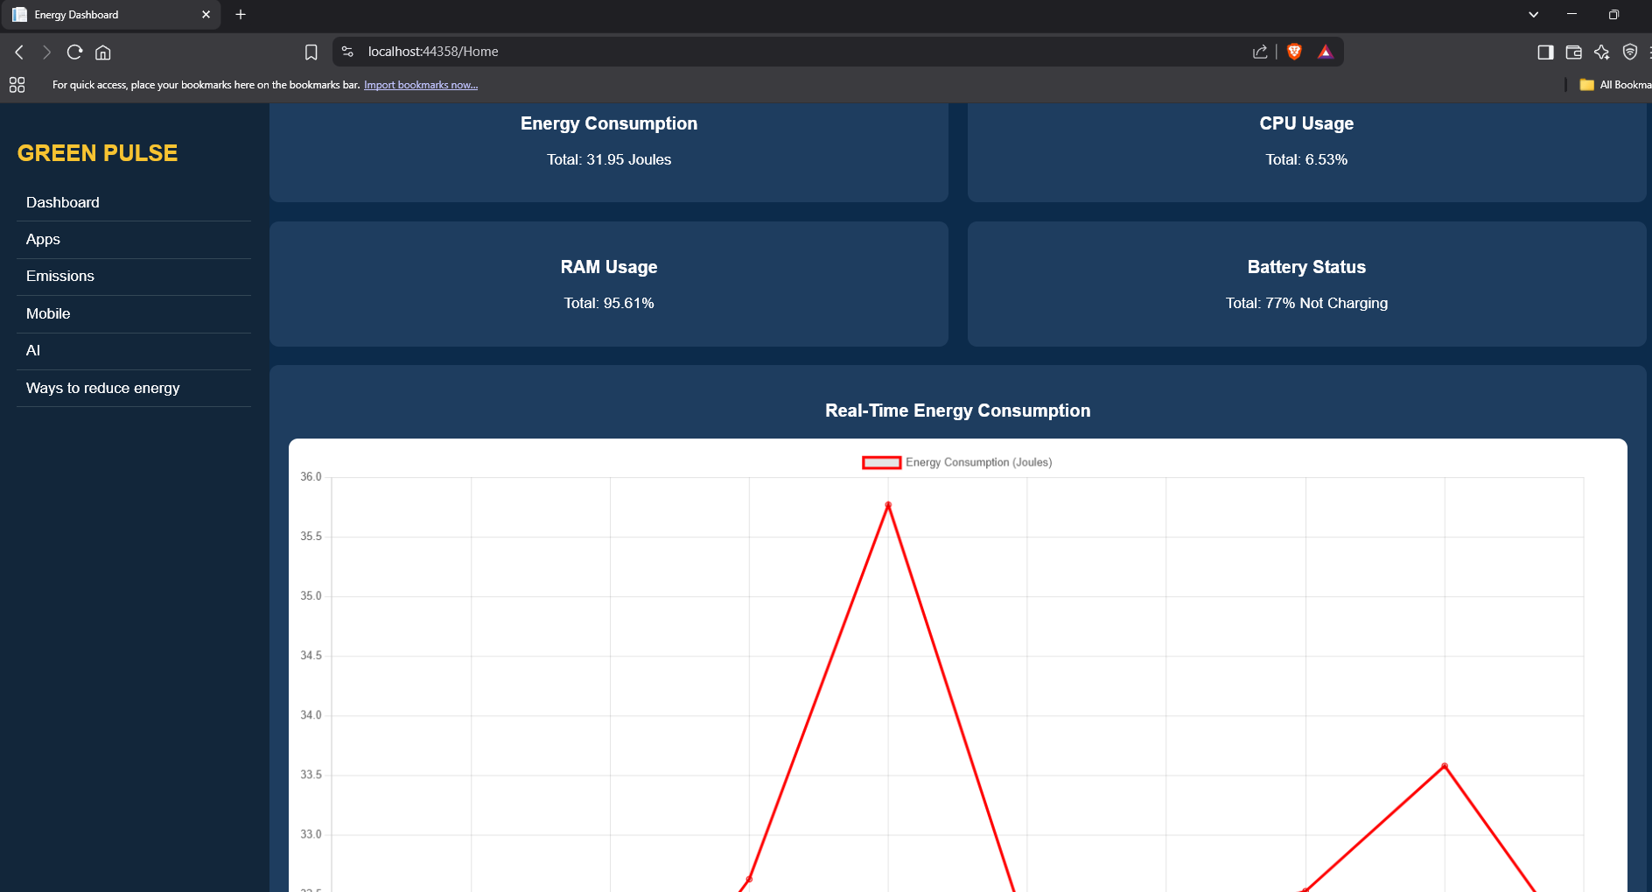

Slide 6
2.PC Apps
The PC Apps module provides detailed monitoring of energy consumption by each active desktop application. Key features include:
Real-time list of all running apps, showing:
CPU usage
Memory usage
Disk activity
Estimated energy consumed using our custom energy formula.
Interactive App Analysis: When a user clicks on any listed app, it displays a real-time line graph of Energy vs Time, showing the app’s behavior over the last 5 time stamps. This visual insight helps identify apps that consistently drain power or spike unexpectedly.
This module supports energy-aware decisions by empowering users to manage or terminate inefficient applications.

Slide 7
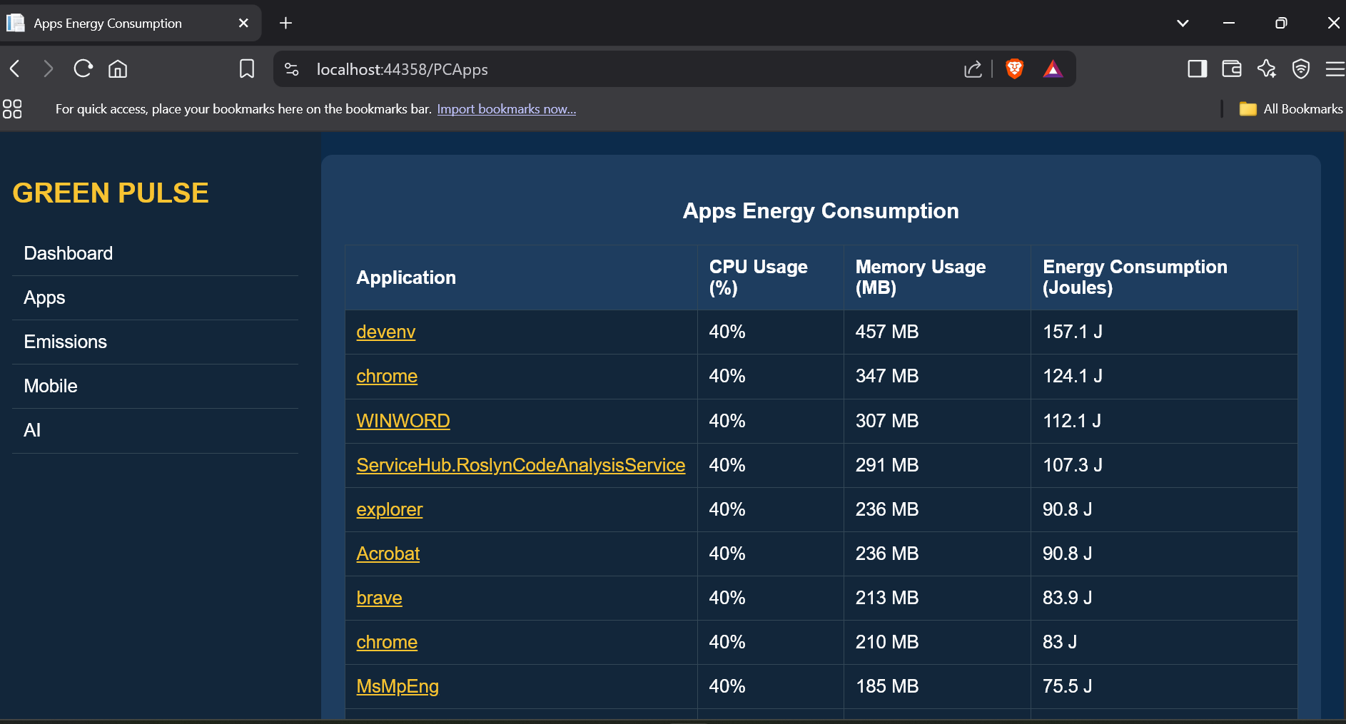

Slide 8
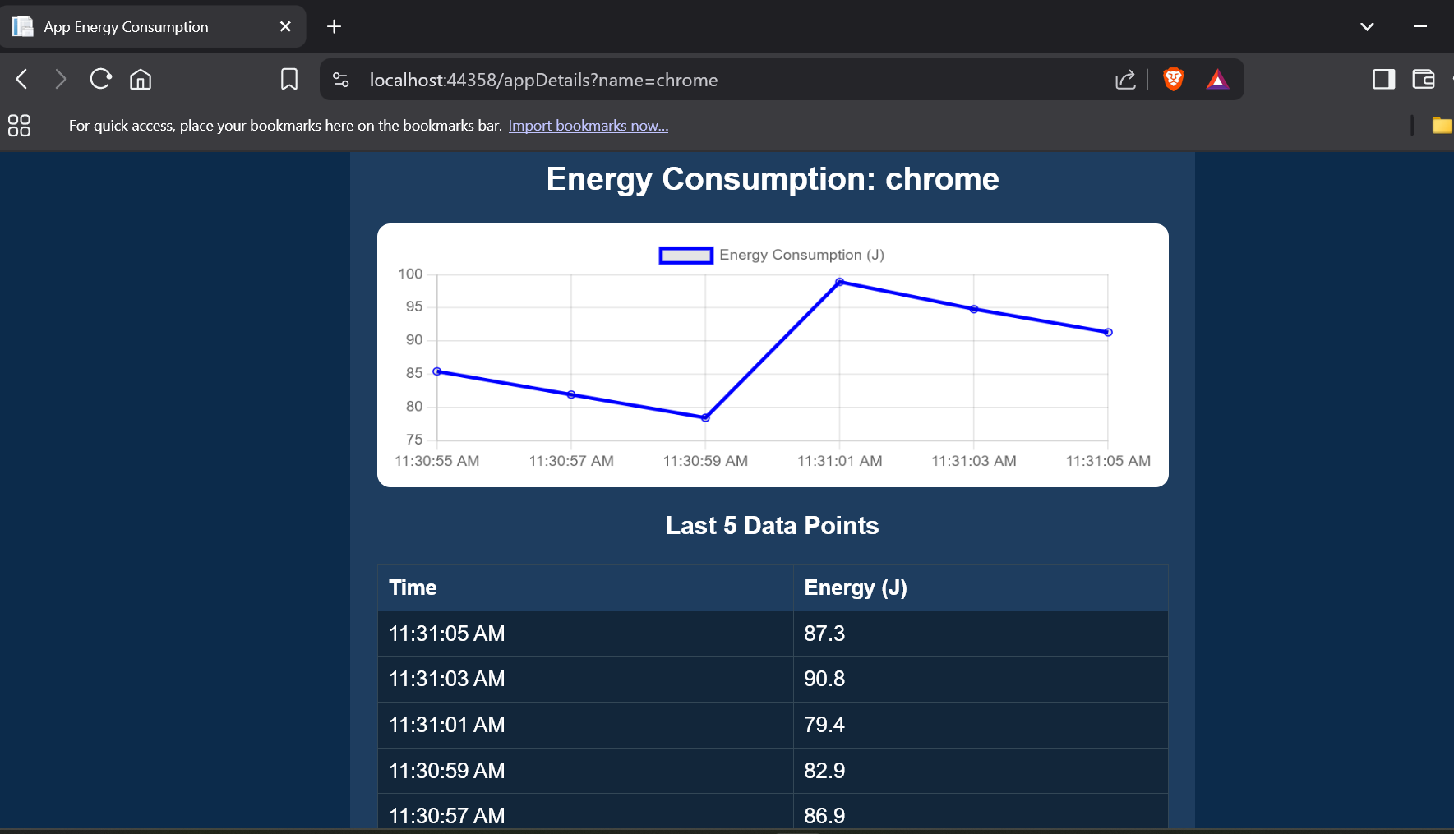

Slide 9
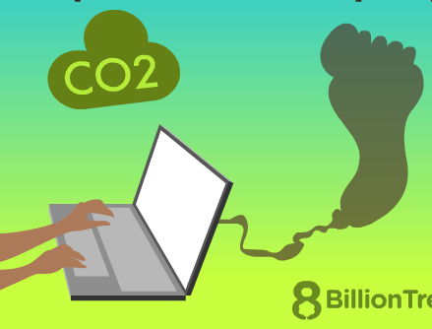
3. EMISSIONS
This section designed to estimate the environmental impact of digital activities by calculating real-time carbon dioxide (CO₂) emissions based on system resource usage. Estimates emissions per second of usage, enabling live tracking.
Uses custom formulas that consider CPU and memory power profiles.
Converts that energy into equivalent CO₂ emissions using a predefined conversion factor.
Conversion factor (e.g., 0.4 g CO₂ per joule) reflects regional grid intensity emission average.
Encourages users to reduce digital carbon footprint.
Makes users conscious of heavy apps or usage patterns contributing most to emissions.

Slide 10
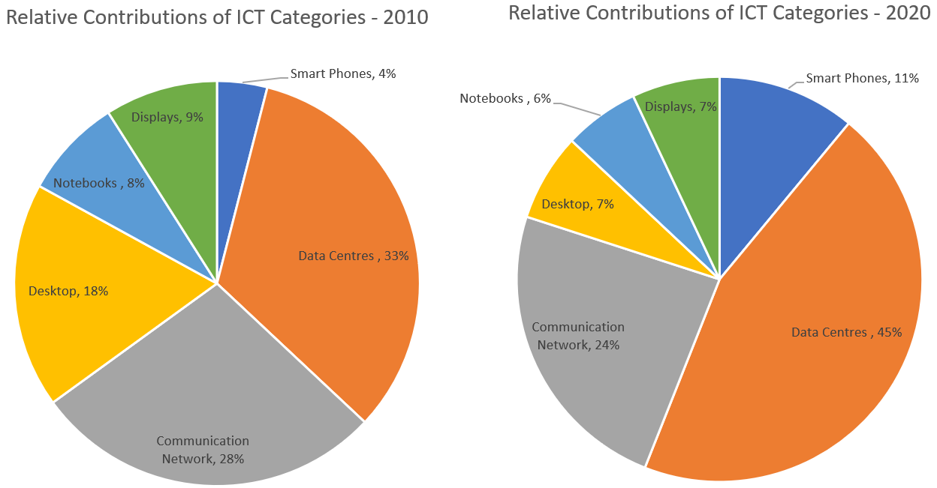
ICT (Information & Communication Technology) sector C02 Emissions Statistics

Slide 11
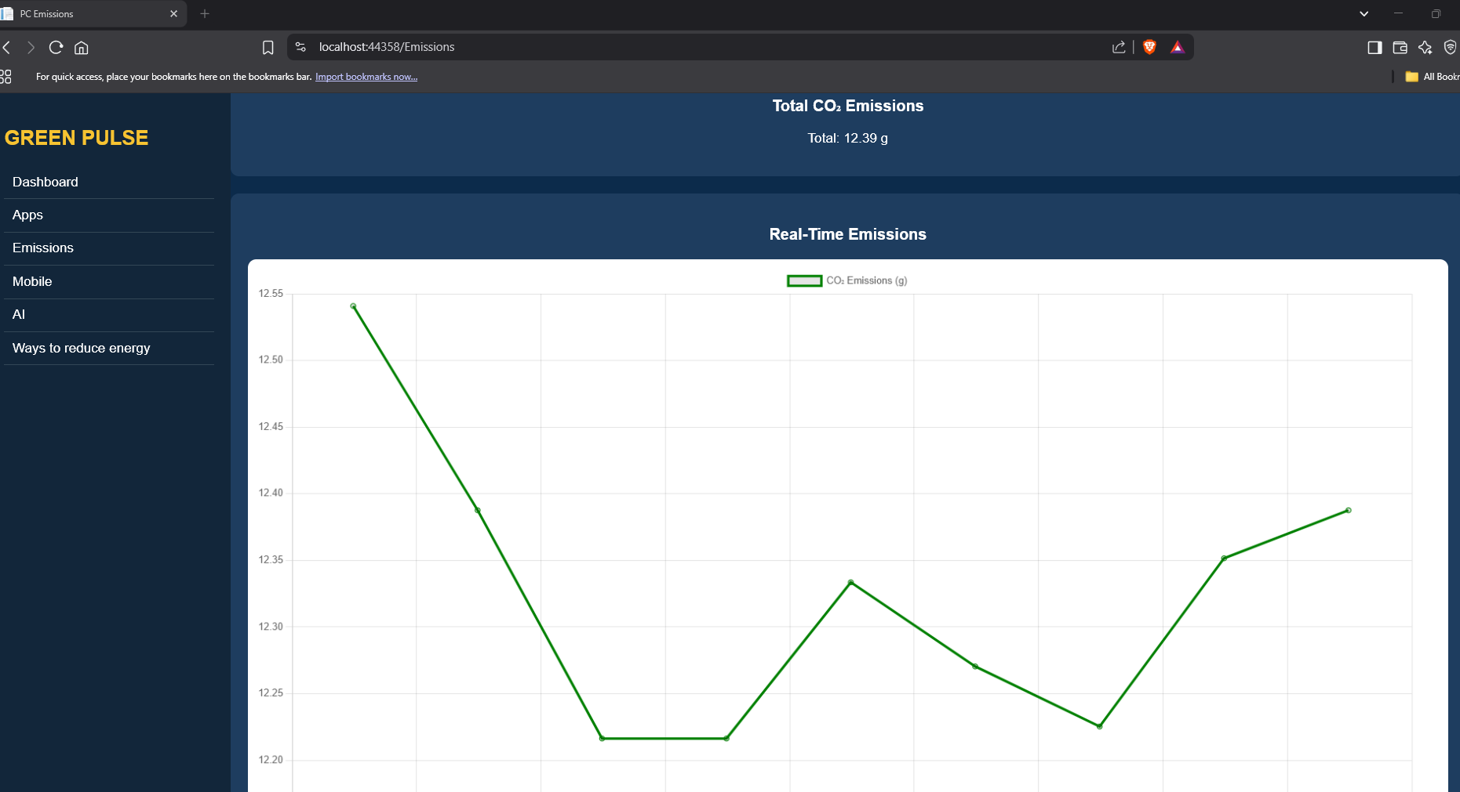

Slide 12
4. MOBILE
Mobile energy consumption refers to the power drawn by hardware components during app or website activity. Essential for optimizing design, prolonging battery life, and improving user satisfaction.
Why Measure Energy Consumption ?
Measuring the energy consumption of mobile devices is essential for several reasons, especially in the context of a sustainable future and eco-conscious usage.
Reduces Environmental Impact: Minimizes carbon emissions from mobile
Improves Battery Life: Prevents excessive drain and extends mobile battery lifespan.
Increases User Awareness: Provides insights to help users optimize power consumption.
Saves Costs: Lowers electricity bills through efficient energy usage.
Enhances App Efficiency: Helps developers optimize energy-heavy processes.
Promotes Longer Device Use: Ensures longer runtimes and fewer recharges.

Slide 13
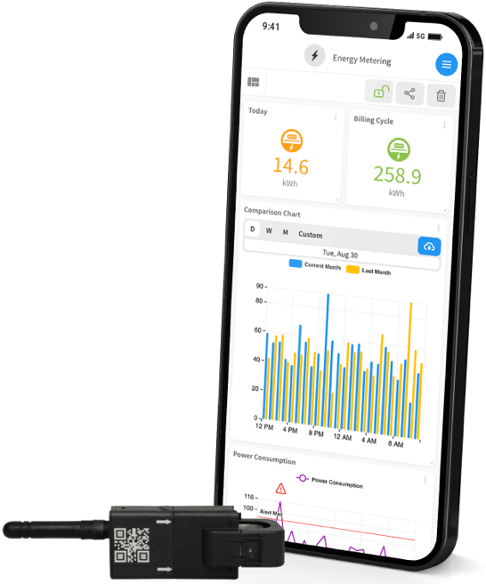
Measurement Techniques for Mobile Energy Consumption
Battery Profiler Tools :Use built-in battery profiler tools on Android and iOS devices to monitor energy usage for apps and websites
Developer Tools : Leverage web browser developer tools to inspect website performance and analyze resource loading patterns.
Energy-Efficient Design Practices : Implement energy-efficient web design principles, such as optimizing images, minimizing JavaScript, and reducing unnecessary animations, to lower energy consumption.

Slide 14
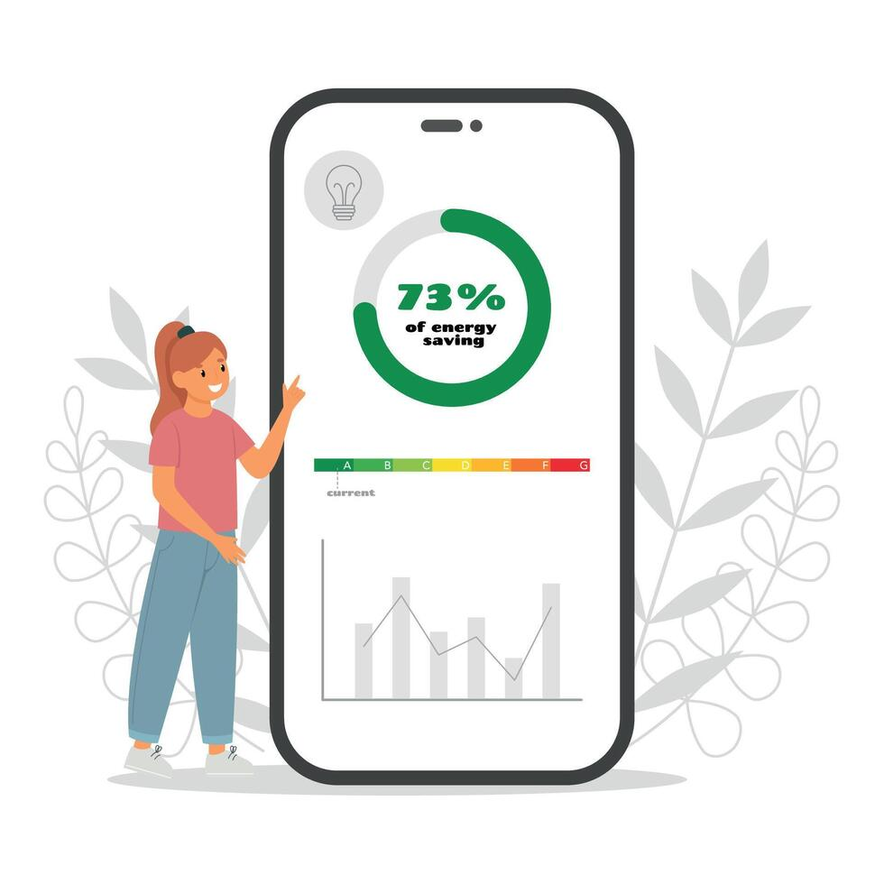
In our system Mobile energy consumption can be calculated based on various factors such as CPU usage, memory usage, screen brightness, and app activities. To monitor real-time energy consumption and system resource usage the steps are :
USB Debugging-Based Monitoring
Connection via ADB (Android Debug Bridge):.
Upon clicking the "Connect" button, ADB initiates communication with the device.
Mobile statistics are continuously fetched for analysis.
Live Monitoring Dashboard
Battery Percentage
RAM Usage
CPU Utilization
Estimated Energy Consumption
Real-Time Graph Interface
Search Box to filter through active apps or services.

Slide 15
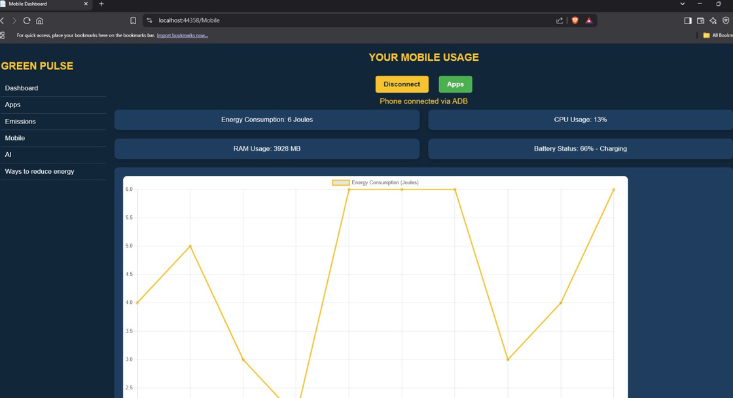

Slide 16
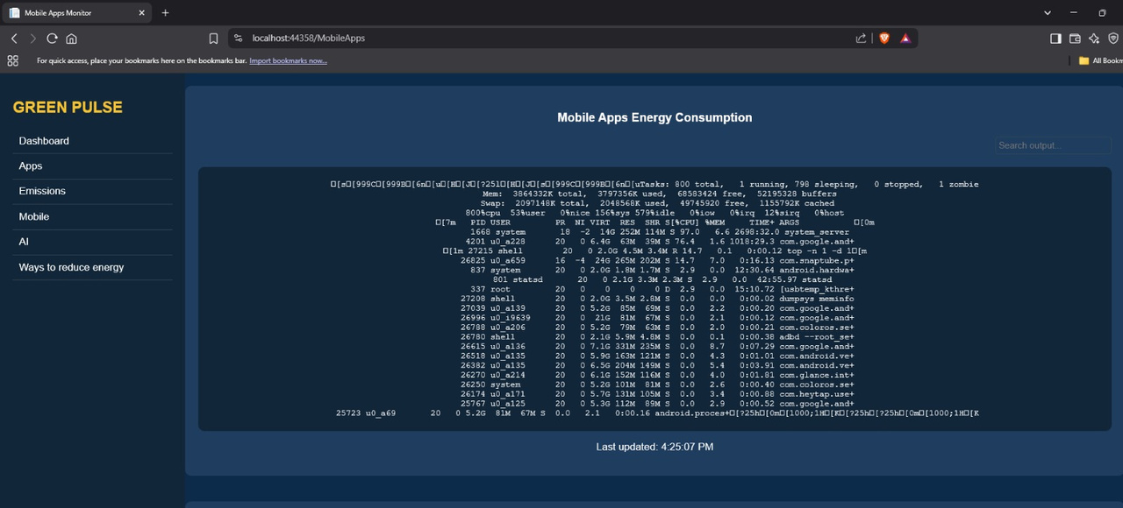

Slide 17
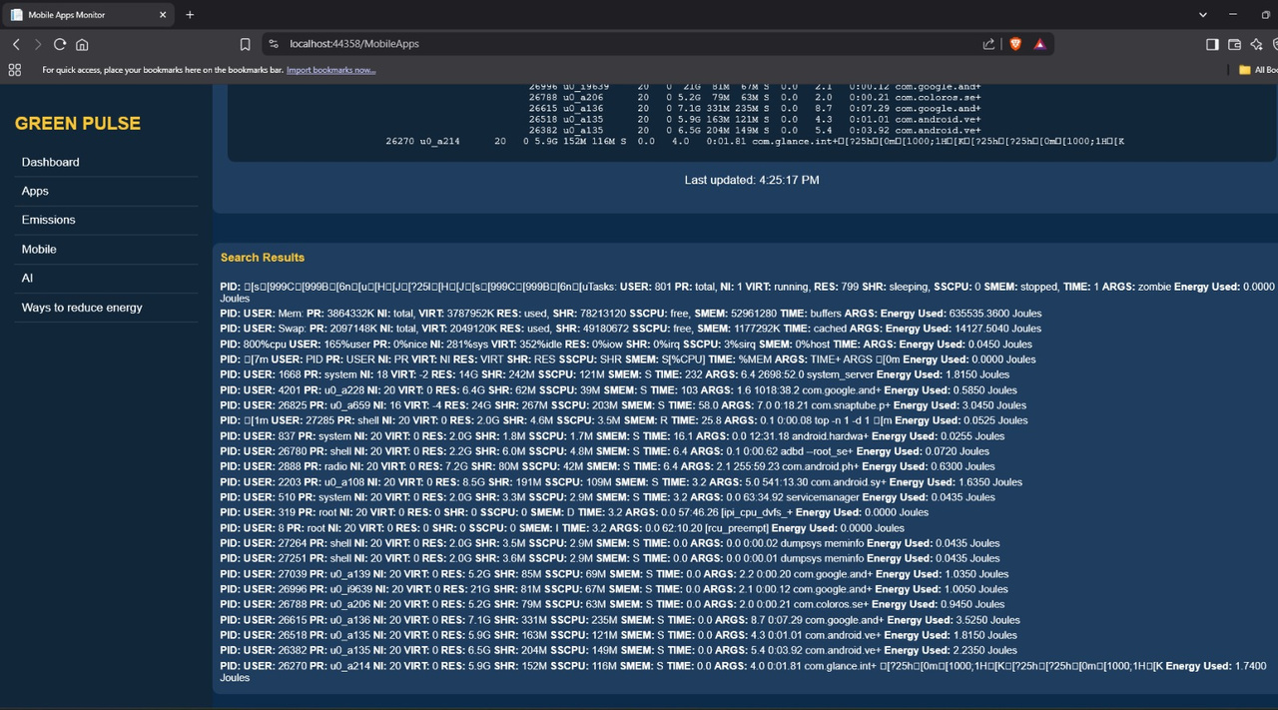

Slide 18
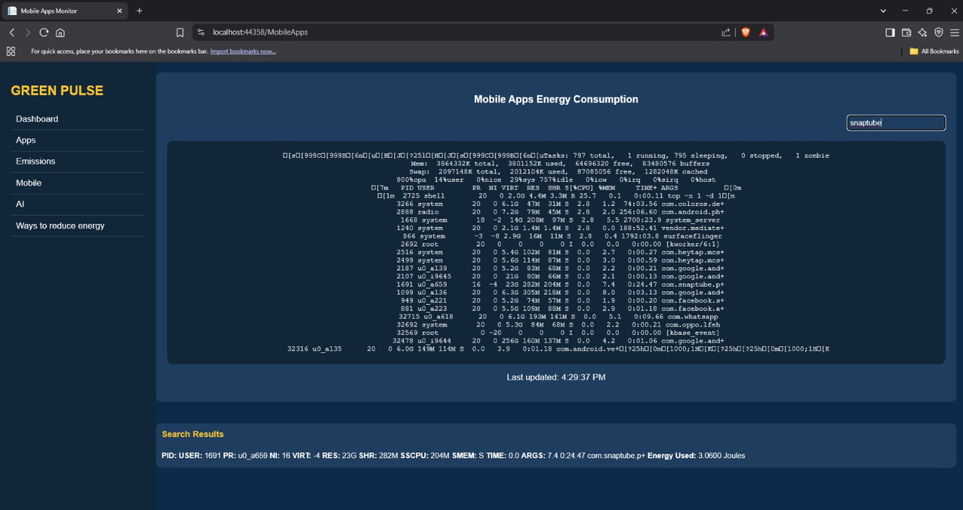

Slide 19
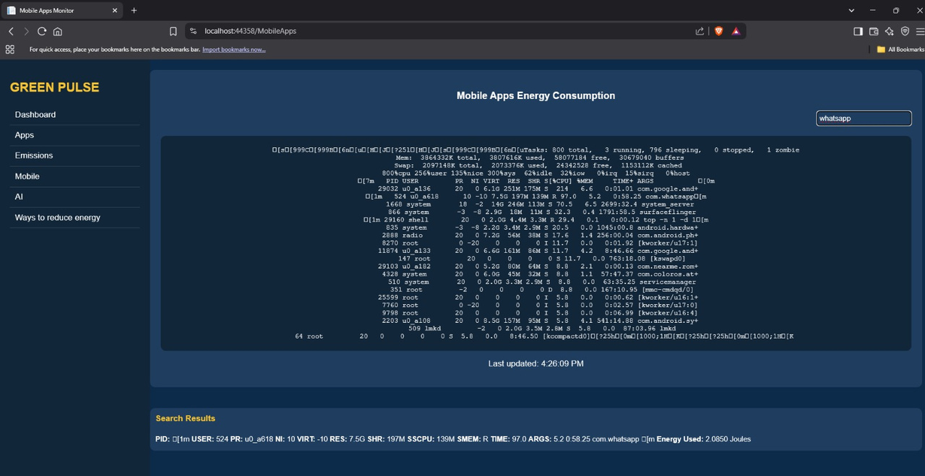

Slide 20
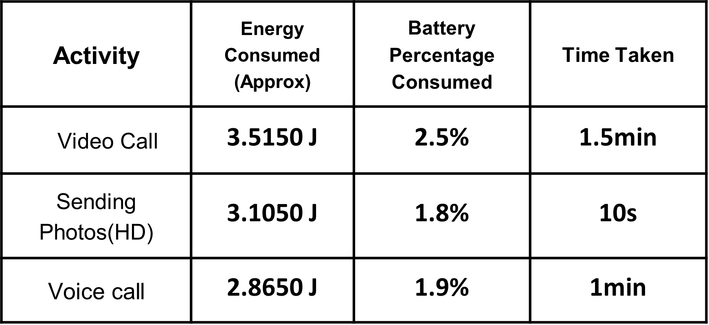
Applications Studied: WhatsApp
Focus on WhatsApp: Power consumption across different usage scenarios (Video Calling, Sending Videos, Sending Photos, Text Chat)
With WhatsApp being a dominant communication tool, analyzing its energy consumption across various activities is critical. Intensive actions like video calling or media sharing draw significantly more power than plain text chatting.
Understanding this helps users manage battery life and helps developers build more efficient features.

Slide 21
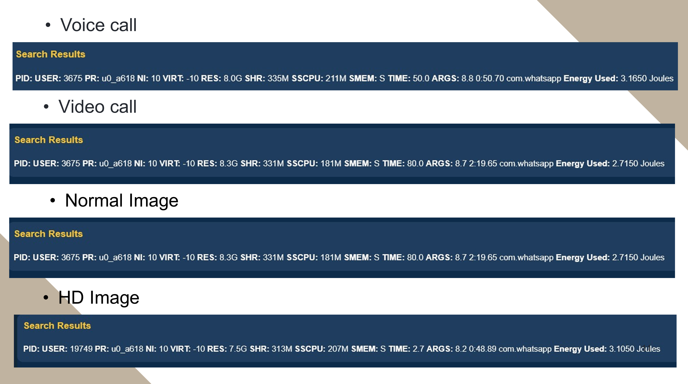

Slide 22
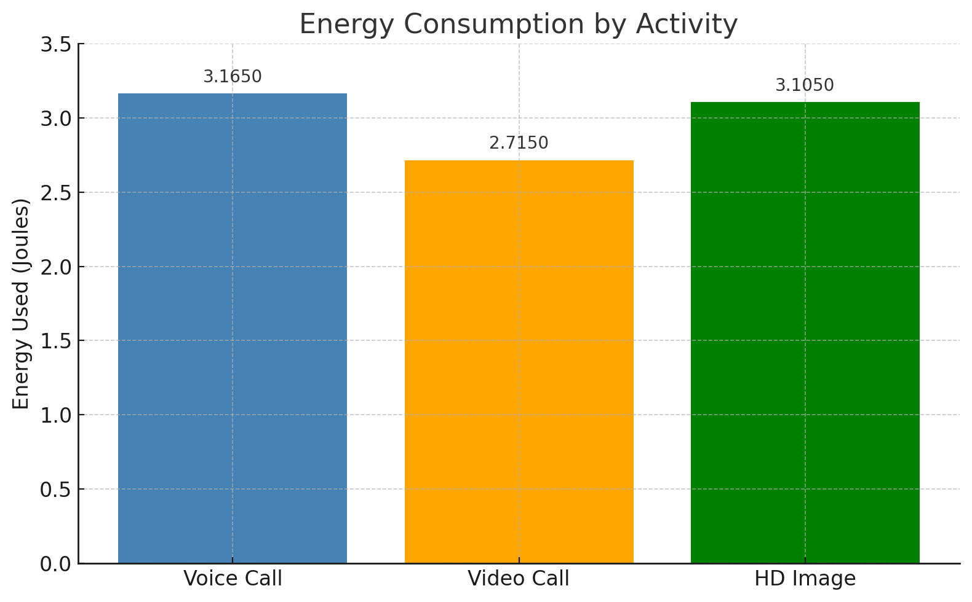
The video call consumed the least energy (2.7150 J) compared to voice call and HD image.
Reason: This lower energy usage is likely because the video call was streamed in low quality due to a poor internet connection, reducing the resolution and data transmission, thus saving energy.

Slide 23
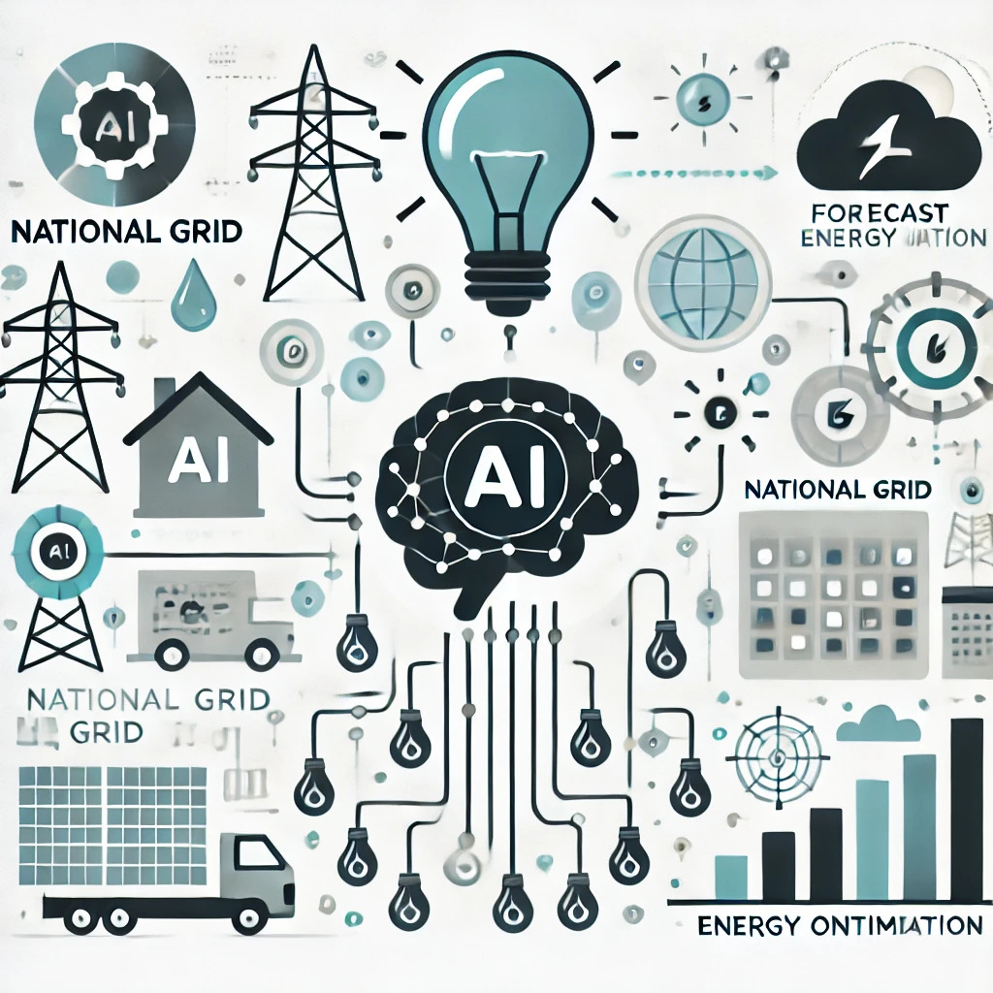
5.AI Energy Consumption Analysis : Monitoring & Measuring the Performance of AI Models with Energy Awareness
As AI continues to evolve, so does its demand for computational power. Every time we train or run an AI model—whether it's classifying images, generating text, or predicting patterns—it consumes energy.
This isn’t just about processing speed or accuracy anymore. In today’s world, energy efficiency has become a key metric in evaluating the performance and sustainability of AI models.
That’s where our AI Energy Consumption Analysis section comes in.

Slide 24
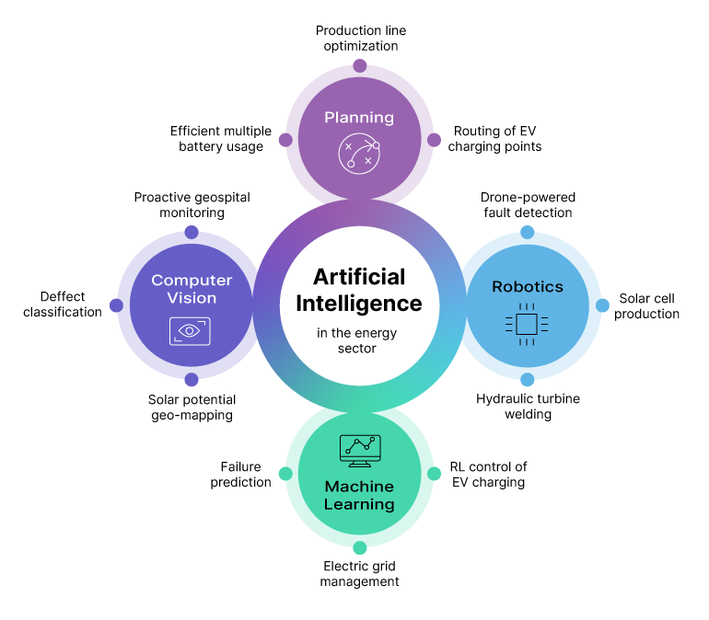
This section of our project is designed to monitor, measure, and visualize how much energy different AI models consume when they run.
Why AI Energy Consumption Matters
Artificial Intelligence (AI) and Machine Learning (ML) have become computationally intensive.
Large-scale models (e.g., deep neural networks) require significant processing power and memory.
These models can consume large amounts of electricity, contributing to carbon emissions and energy costs.
Measuring and optimizing energy consumption is crucial for building greener, more sustainable AI systems.

Slide 25
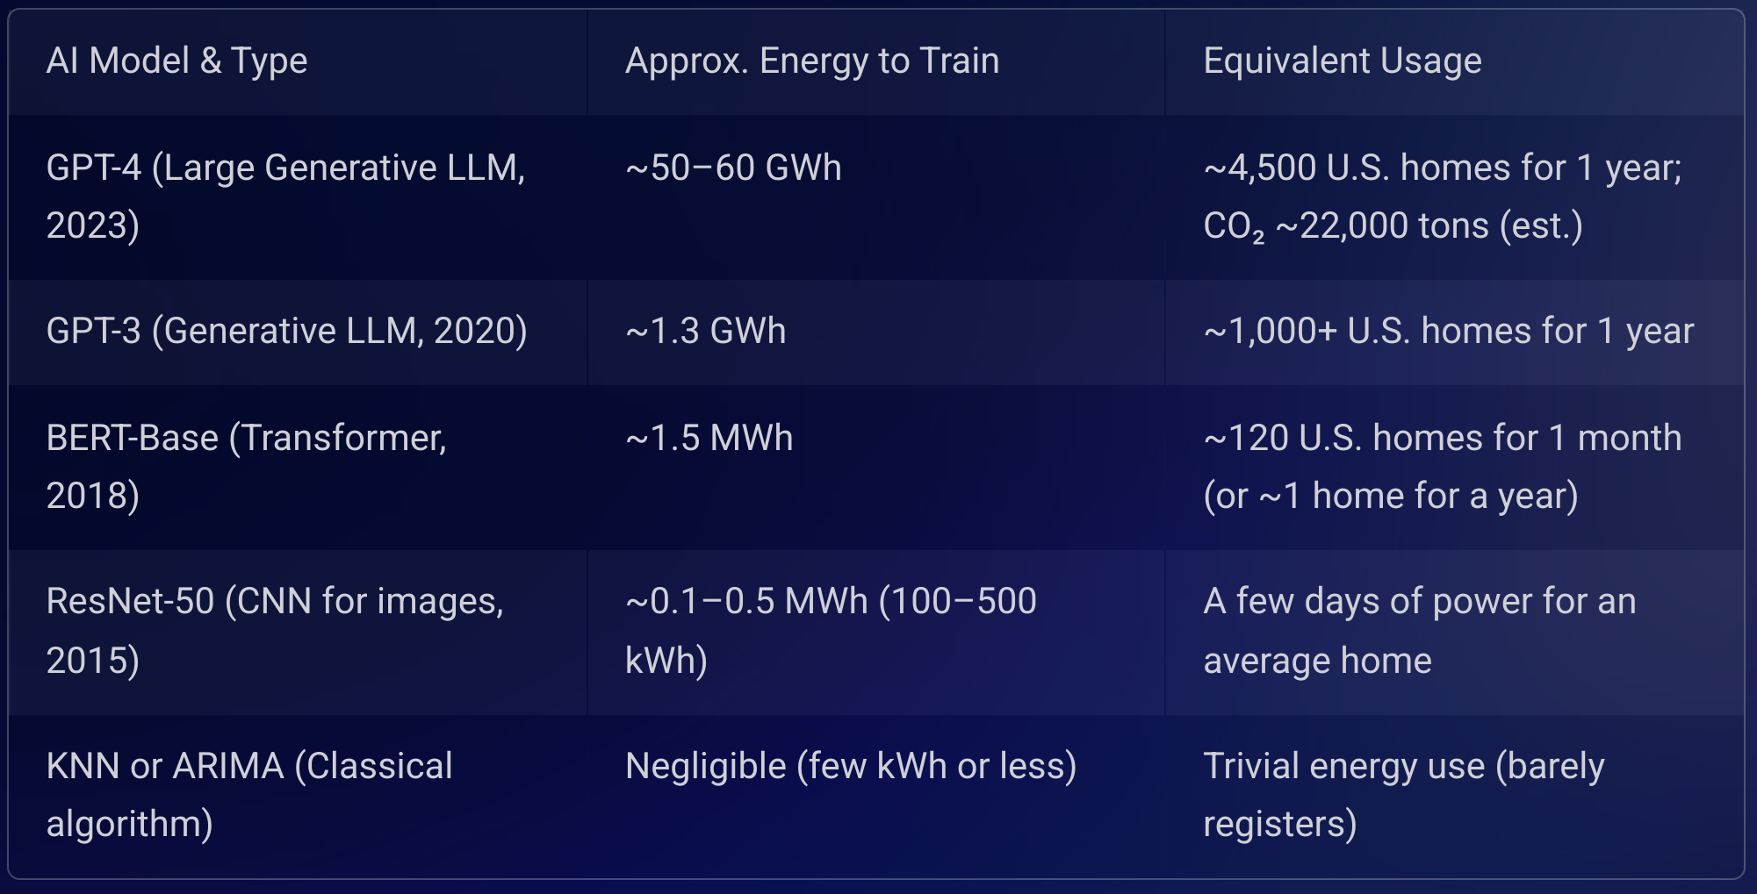
Energy Consumption in AI Models

Slide 26
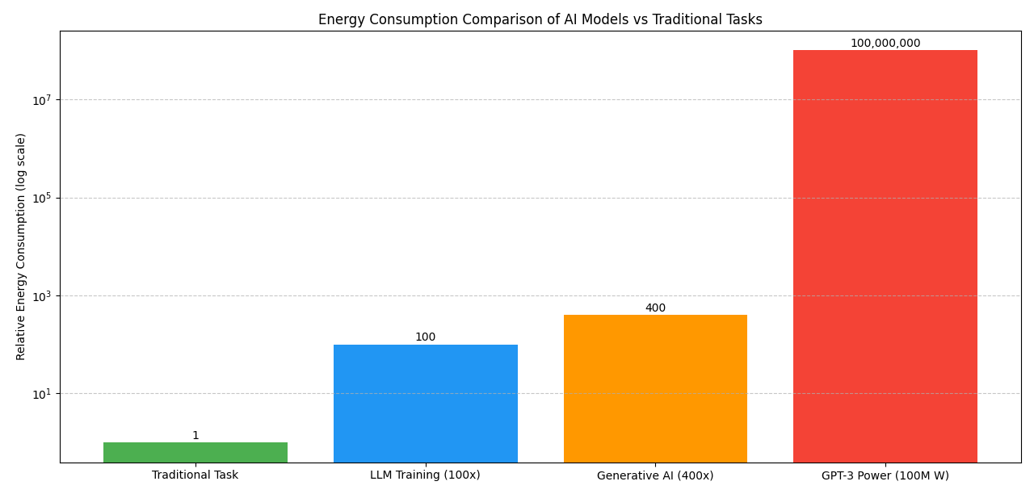
This visualization dramatically illustrates the energy difference between AI models (especially generative AI like DALL-E 2 and GPT-3) and traditional computing. Note the staggering contrast: GPT-3's power demand (100 million watts) is equivalent to thousands of homes' combined energy use.

Slide 27
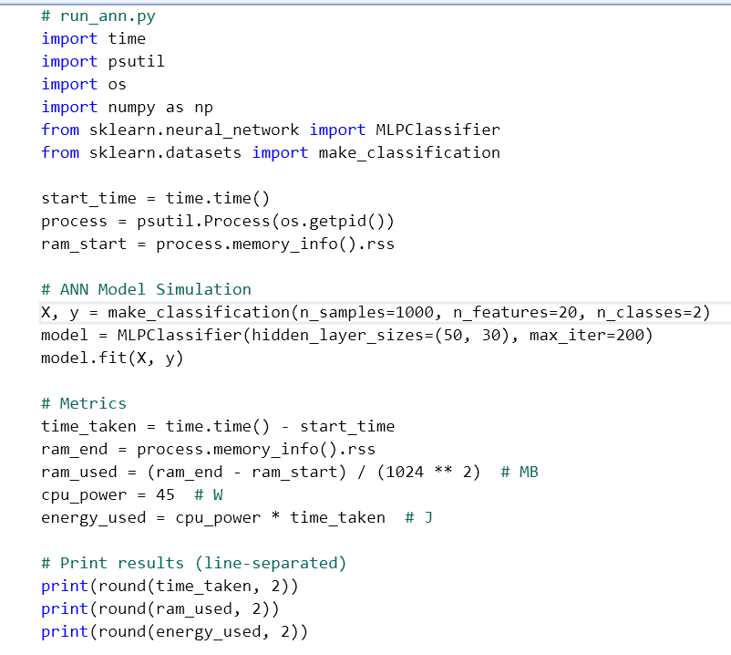
The code simulates the monitoring of system resource usage and estimates energy consumption during an ANN model's execution.
ANN via MLPClassifier from scikit-learn
Type: Feedforward Artificial Neural Network (Multilayer Perceptron)
Input layer: 20 features
Hidden layers: Two layers with 50 and 30 neurons respectively
Output layer: 2 classes (binary classification)
Activation Function: ReLU (by default for hidden layers)
Solver: Adam (default)
Iterations : 200
Loss Function: Log-loss (cross-entropy)
In short, it's a simple 2-hidden-layer ANN for classification, trained on synthetic data.

Slide 28
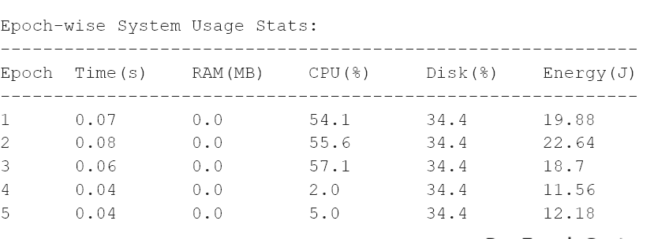
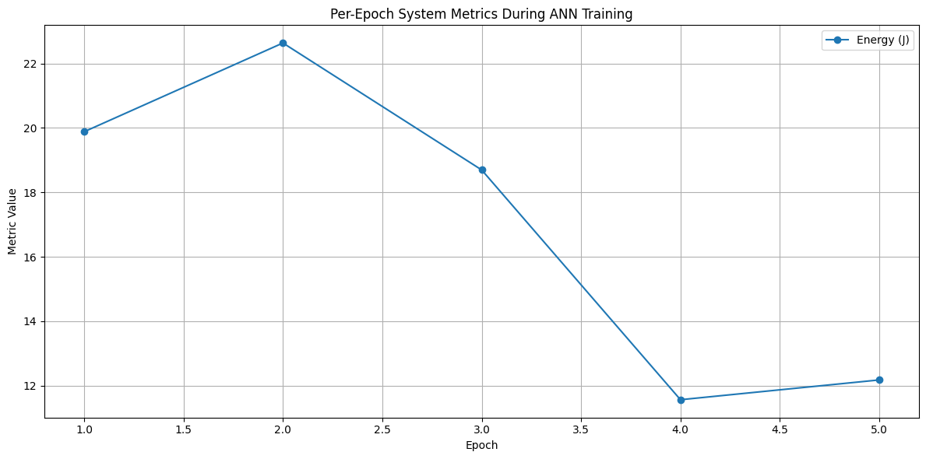
OUTPUT : The first 5 iterations results are shown , the avg. of energy for 200 iterations is calculated in our system.

Slide 29
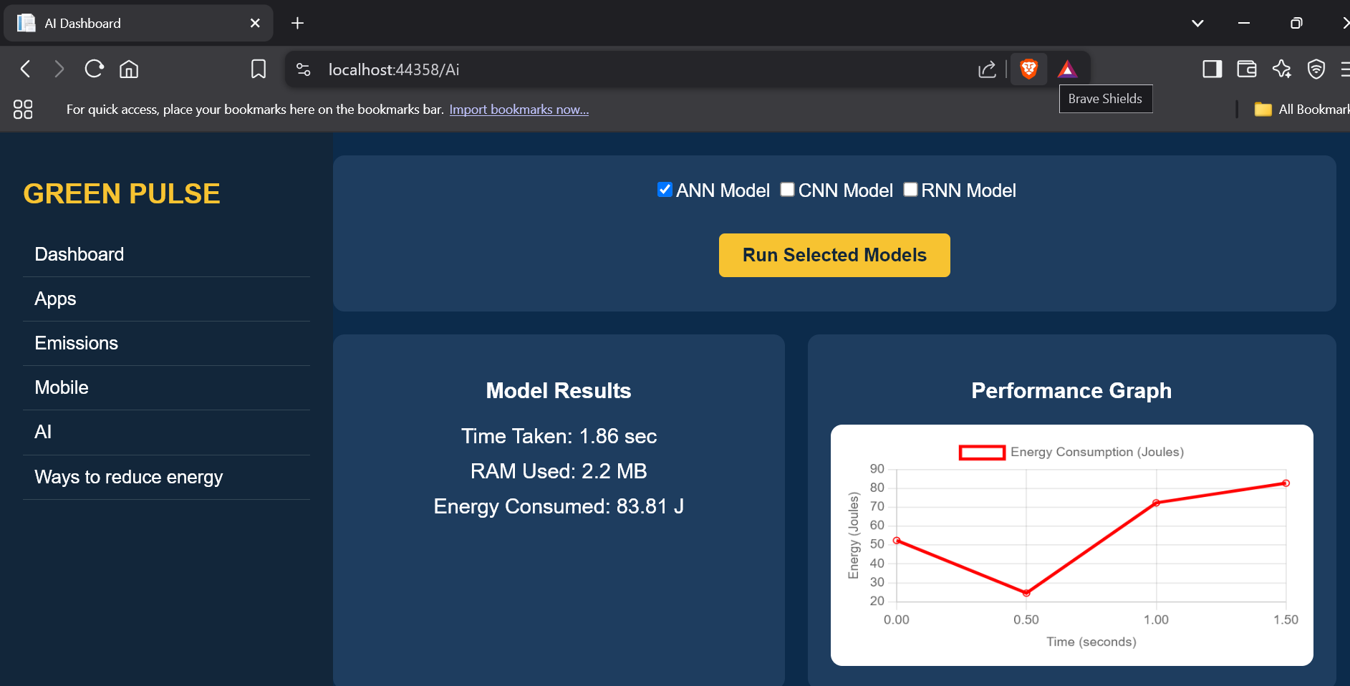
Similarly We can show the energy consumption for CNN , RNN models and also We can Upload our own Model

Slide 30
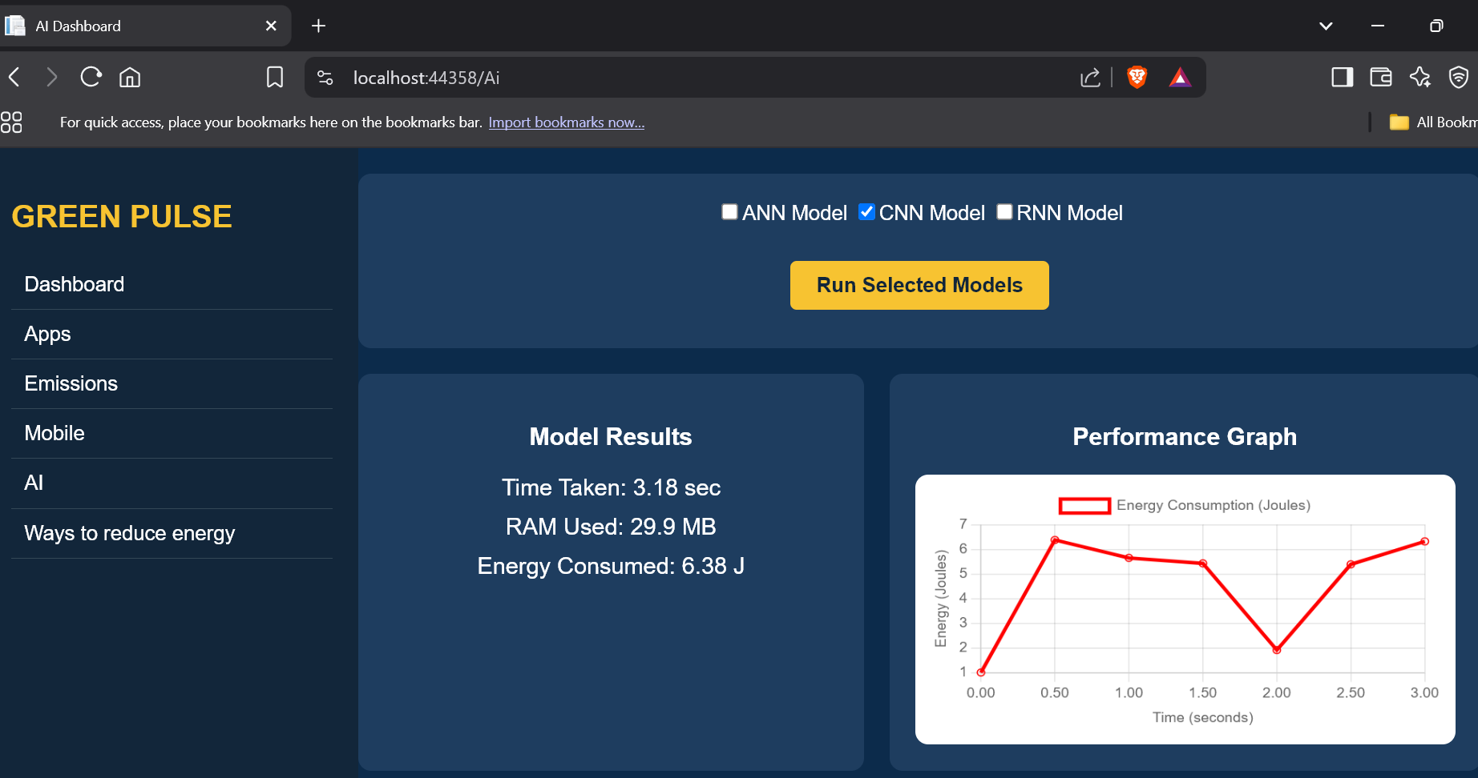
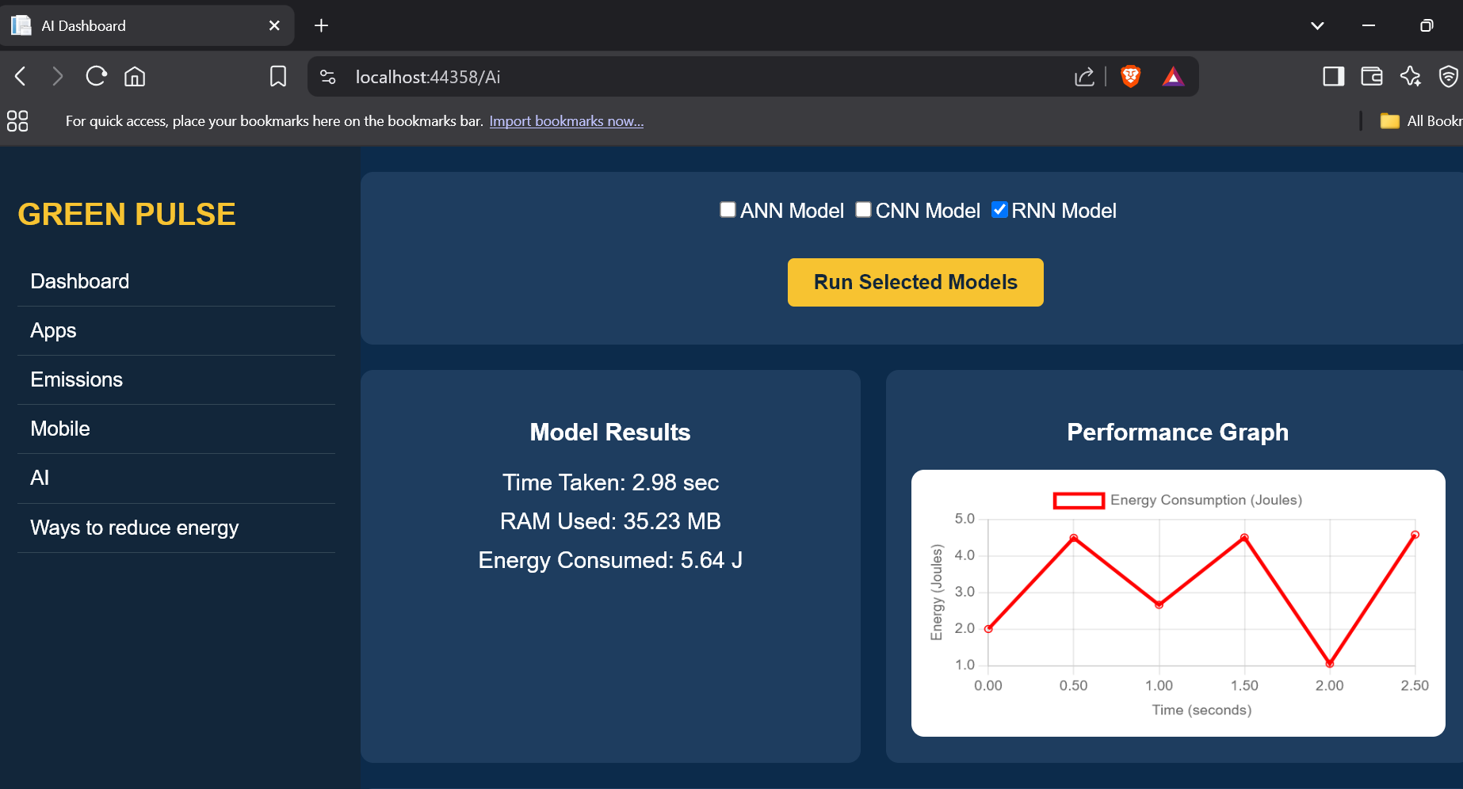
Results : CNN
Time Taken : 3.18sec
RAM Used : 29.9 MB
Energy Consumed : 6.38 J
Results : RNN
Time Taken : 2.98sec
RAM Used : 35.23 MB
Energy Consumed : 5.64 J

Slide 31
Energy Comparison: AI Models vs. Traditional Computing Tasks
AI Models
Traditional Computing Tasks
Computational Demands
High; complex algorithms, large datasets
Low; simpler algorithms, smaller data sets
Hardware Requirements
High-performance GPUs/TPUs
Standard CPUs
Energy Consumption (Training)
Very High
Low
Energy Consumption (Inference)
Moderate to High
Low
Overall Energy Impact
Significantly higher
Significantly lower

Slide 32
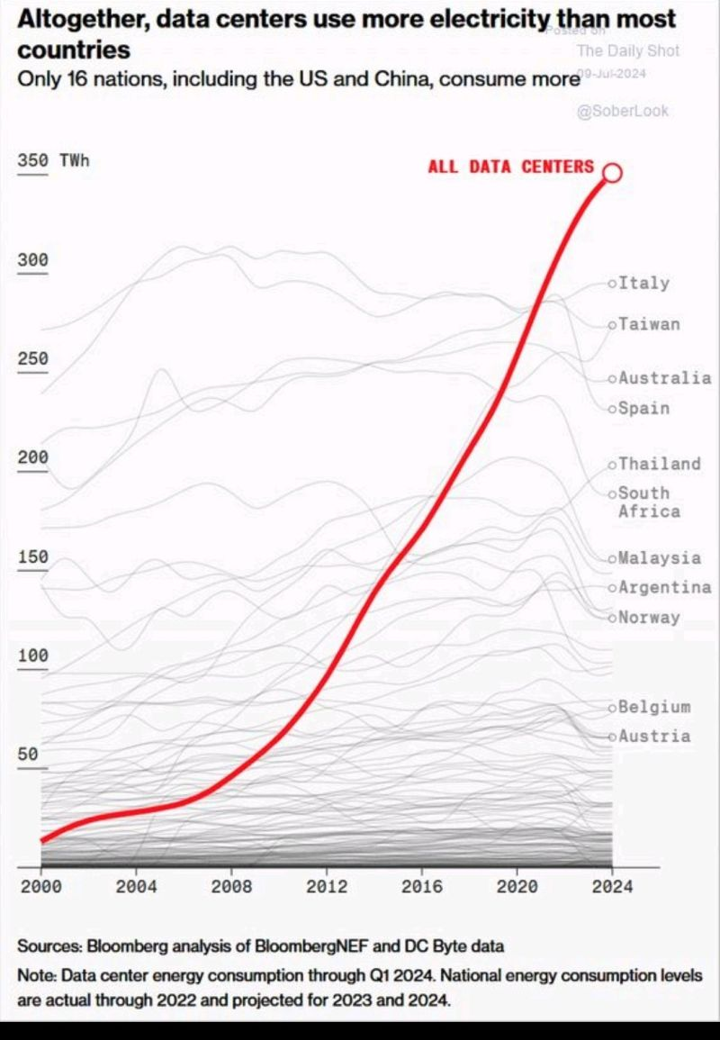
AI's Energy Impact and Its Implications on Global Energy Consumption
The rapid growth of Artificial Intelligence (AI) has revolutionized industries, from healthcare to finance.
Training and running AI models—especially deep learning models—demand massive computational power. This leads to a significant increase in energy consumption, raising serious environmental concerns.
Large-scale AI models, such as GPT or BERT, require thousands of GPUs and weeks of training—consuming more electricity than some small countries.
Data centers powering AI services are responsible for millions of tons of CO₂ emissions annually.
Inference (real-time use of AI models) at scale also adds to the energy burden due to the need for continuous computation.

Slide 33

Sustainable AI Development
To reduce AI’s environmental footprint, the industry is moving towards green and sustainable AI practices, such as
Designing energy-efficient architectures (e.g., quantized models, pruning).
Using renewable energy sources to power data centers.
Implementing model optimization techniques to reduce training time and computation.
Encouraging energy transparency through tools that measure and report model energy usage.
Sustainable AI isn't just an ethical imperative—it’s a technical challenge and opportunity to design intelligent systems that are both powerful and planet-friendly.

Slide 34
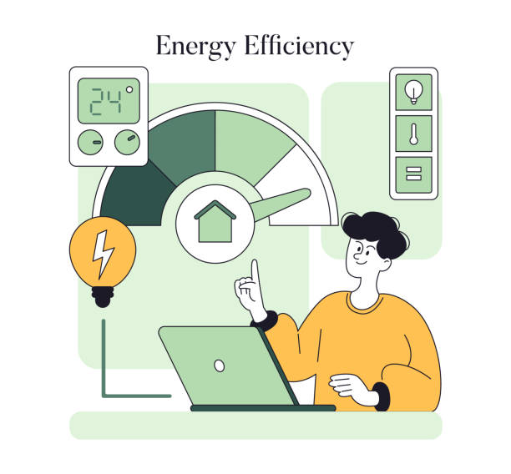
6.Reducing Energy Consumption
“As our reliance on digital infrastructure grows, so does the demand for power.”
Green Pulse addresses this challenge by providing real-time insights, intelligent controls, and actionable strategies to optimize energy usage across PCs and mobile devices.
Through this project, we aim not only to enhance system efficiency but also to contribute meaningfully to a greener, more responsible digital future.

Slide 35
Why do we need to reduce energy consumption in PCs or Mobiles ?
To Lower Electricity Costs Reducing energy use directly decreases power bills for individuals, businesses, and institutions.
To Minimize Environmental Impact Less energy consumption means fewer carbon emissions, contributing to climate change mitigation.
To Increase Hardware Lifespan Efficient energy usage reduces heat and wear on components, extending the life of devices.
To Improve Battery Performance On laptops and portable devices, lower energy use leads to longer battery life and reduced charging frequency.

Slide 36

To Enhance System Performance Energy-efficient systems tend to run cooler and more reliably, avoiding performance throttling due to overheating.
To Reduce Peak Load on Power Grids Efficient usage helps avoid overloading power infrastructure, especially in offices or data centers.
To Encourage Sustainable Technology Practices Promotes responsible usage of computing resources and aligns with corporate and institutional sustainability goals.
To Support Global Energy Conservation With billions of PCs in use globally, small individual savings can lead to significant collective impact.

Slide 37

Ways to Reduce Energy Consumption
For PCs (Desktops & Laptops):
Enable Power Saving Settings
Use Efficient Hardware
Optimize Software Usage
Unplug Peripherals
Update Drivers & OS

Slide 38
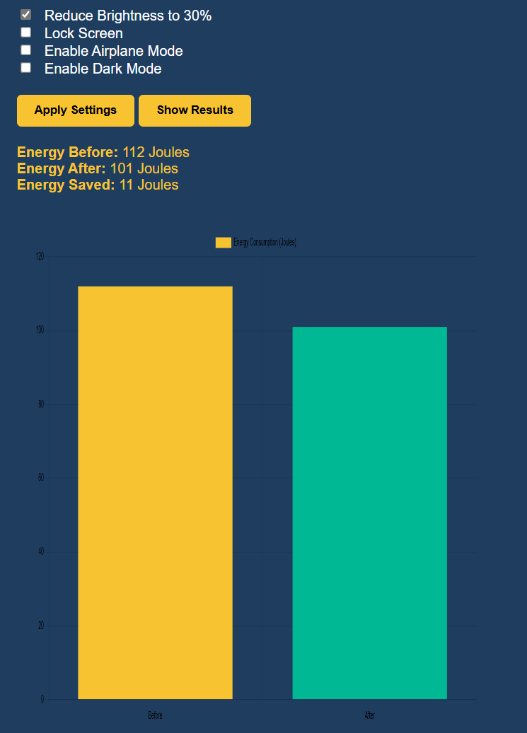
Example - Reducing Brightness to Save Energy
Energy Consumption Reduced
Brightness reduction to 30% resulted in energy usage dropping from 112 Joules to 101 Joules, saving 11 Joules.
Immediate and Measurable Impact
The change is reflected clearly through the visual comparison in the bar graph, showing a significant drop in power usage.
Minimal Action, Notable Effect
A single user action (reducing brightness) yields measurable energy savings without affecting core system performance.
Simple Yet Effective Practice
This technique requires no additional software or hardware changes, making it one of the easiest energy-saving strategies.
In environments like schools, offices, or labs, applying brightness reduction across multiple systems can lead to substantial cumulative savings.
Reducing display brightness is a small step with a large environmental benefit when applied widely.

Slide 39
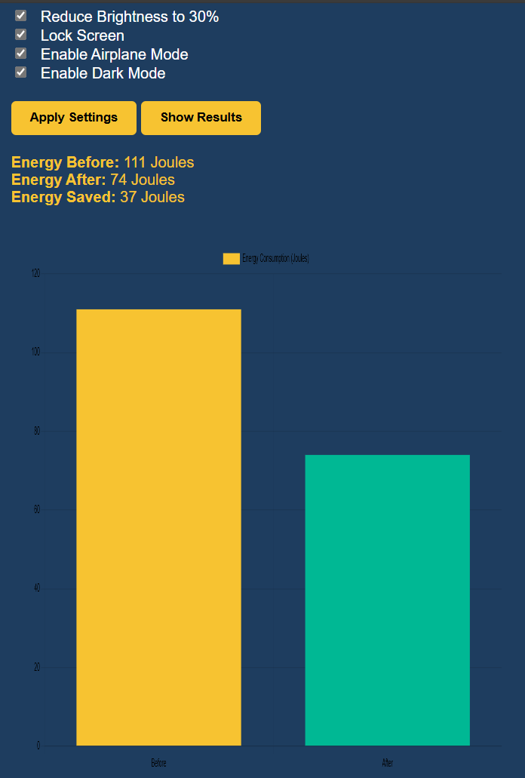
Impact of Multiple Energy Reduction Techniques on PC Power Usage
Applying a combination of energy-saving features leads to significantly higher energy savings than using a single method.
Airplane Mode disables network components like Wi-Fi and Bluetooth, reducing background communication and idle energy drain.
Dark Mode reduces energy consumption, especially on OLED and LED screens, by limiting bright pixel usage.
Reducing Brightness remains a consistently effective method to lower display power use.
Locking the screen when away reduces CPU and GPU activity, pauses background tasks, and dims or turns off the display sooner, resulting in further energy savings during idle time.
These changes can be implemented instantly without any external tools or hardware.
If scaled across multiple systems in labs or offices, these small savings can contribute to substantial overall energy conservation.

Slide 40
Ways to Reduce Energy Consumption for AI Systems (Servers, Training Models):
Model Optimization:
Use model pruning, quantization to reduce size and inference cost.
Efficient Architectures:
Favor energy-efficient models like MobileNet, EfficientNet, or TinyML for edge applications.
Batch Inference:
Process data in batches to maximize hardware utilization and reduce idle times.
Use Green Data Centers:
Run models on providers using renewable energy (e.g., Google Cloud,Azure green zones).
Train with Purpose:
Avoid overtraining or unnecessary hyperparameter tuning.
Leverage Edge AI:
Deploy inference on edge devices where possible to avoid energy-intensive cloud operations.

Slide 41
Limitations
Platform Dependence: Currently limited to Windows and may rely on system-specific tools (e.g., PowerShell, ADB).
Hardware Dependency: Accuracy in energy measurement may vary depending on the availability of onboard sensors.
No Deep App-level Analysis: Does not analyze specific app behavior or code inefficiencies contributing to high energy usage.
Manual Execution of Scripts: Requires user input for activating certain energy-saving options or running models.
Limited Real-time Capabilities: Graphs and analysis are typically available only post-execution, not continuously live.
Security Concerns: Running scripts (PowerShell, Python) can pose risks if not securely sandboxed or validated.

Slide 42
Future Scope
Cross-platform Expansion: Extend support to macOS, Linux, and Android/iOS devices for comprehensive energy monitoring.
AI-based Recommendations: Use machine learning to suggest optimal energy-saving strategies based on user behavior and workload patterns.
Smart Scheduling: Automate energy-saving modes (e.g., hibernate, brightness reduction) based on time of day or idle activity.
IoT Integration: Connect with smart home/office devices to regulate power consumption at a broader level.
Cloud Monitoring Dashboard: Provide remote access to system stats, energy trends, and control features via a web/cloud interface.
Real-time Alerts: Notify users instantly when energy thresholds are crossed, or performance degrades due to high resource usage.
Organization-wide Deployment: Scale the solution for enterprise environments to monitor and control energy across multiple systems.

Slide 43
Conclusion
Comprehensive Monitoring: Green Pulse offers a web-based solution that tracks energy consumption in real-time across PCs and mobile devices.
Energy & Emission Insights: The system provides actionable analytics on energy usage, AI model optimization, and CO₂ emission reduction.
Integrated Backend Technologies: Utilizes Python for AI model energy tracking and PowerShell for executing energy-saving actions.
User-Friendly Interface: Simplifies complex data into accessible visuals, enabling users to monitor apps, services, and environmental impact easily.
Sustainable Impact: Supports individuals and organizations in reducing their carbon footprint and promoting environmental sustainability.
Access all the files through this link :-
https://drive.google.com/drive/folders/1dRdhdWZ_DI2WLn Sqxf2OE-zJvmJvYLE7?usp=sharing

Slide 44
References
https://www.instructables.com/Real-time-Web-Based-Household-Power-Usage-Monitor/
https://medium.com/swlh/electricity-usage-dashboard-7b0b31f866d1
https://huggingface.github.io/AIEnergyScore/
https://arxiv.org/abs/2103.16435
https://www.carbonfootprint.com/calculator.asp
https://davidsuzuki.org/living-green/how-to-reduce-your-digital-carbon-footprint/
https://github.com/Protik49/12-Open-Source-Tools-for-Monitoring-Software-Energy-Consumption
https://www.iea.org/reports/data-centres-and-data-transmission-networks
https://ccaf.io/cbeci/inde
https://sustainability.google/reports/environmental-report-2022/
https://ethereum.org/en/upgrades/merge/
Strubell, E., Ganesh, A., & McCallum, A. (2019). Energy and Policy Considerations for Deep Learning in NLP. arXiv:1906.02243.
https://datacenters.google/efficiency/

Slide 45
THANKYOU

